Slide 1
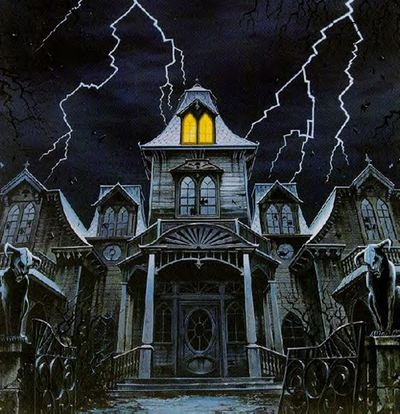
The Good, The Bad And The Ugly…
Trying Cases With Really Bad Documents
November 29, 2012
www.FulkersonLotz.com

Slide 2




Dealings Become Data
Information is Generated and Shared Abundantly
Stored
Backed-up
Made Someone Else’s Responsibility
Notes:
What creates Bad Documents?
Was it always this bad?
Short Answer: No.
At least the following are contributors
E-mail creates a false atmosphere of privacy and informality
Modern computer and file server systems record everything unless instructed to destroy it
Most companies have extensive back-up procedures
In a shrinking resource environment, employees don’t want to be the last person left standing in a game of corporate musical chairs. They don’t want to be blamed for major corporate problems.

Slide 3
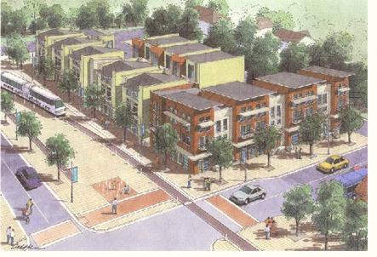
Mixed Use Development –
Condominiums, Retail and Apartments
ACCO
LLC
35 Investors, $3 million each = $105 million total
Started 2005, Target Completion Date = July 1, 2007
Notes:
Our Hypothetical
Acco LLC is a real estate developer centered in Houston
In 2005 it began developing a mixed use condominium, retail and apartment property
35 investors have put $3 million apiece into the project
The sophisticated investors confirm a net worth of at least $10 million, that they are aware the investment is high risk and they may lose all

Slide 4
Mixed Use Development –
Condominiums, Retail and Apartments
ACCO
LLC
Cost Overruns
Permitting Problems
Liquidity Crisis
Bad General Cont.
Construction Delays
$25 Million in Additional Funding Required
Completion Date Pushed from July, 2007 to Dec. 31, 2008
Notes:
Our Hypothetical (2)
The project becomes very late, mostly due to permitting problems
The first general contractor had to be fired and replaced, resulting in liens and litigation
Original completion was to be July 1, 2007, but it is pushed back to December 31, 2008
The project is caught up in the nation’s liquidity crisis, 250 of the 500 committed pre-construction sales opt out or default
New Funding of $25mm is required to finish

Slide 5
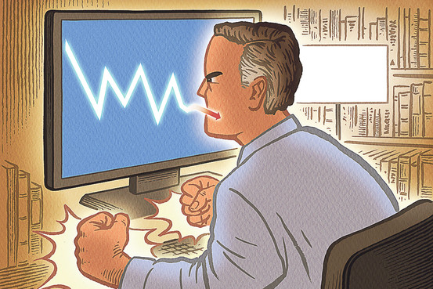
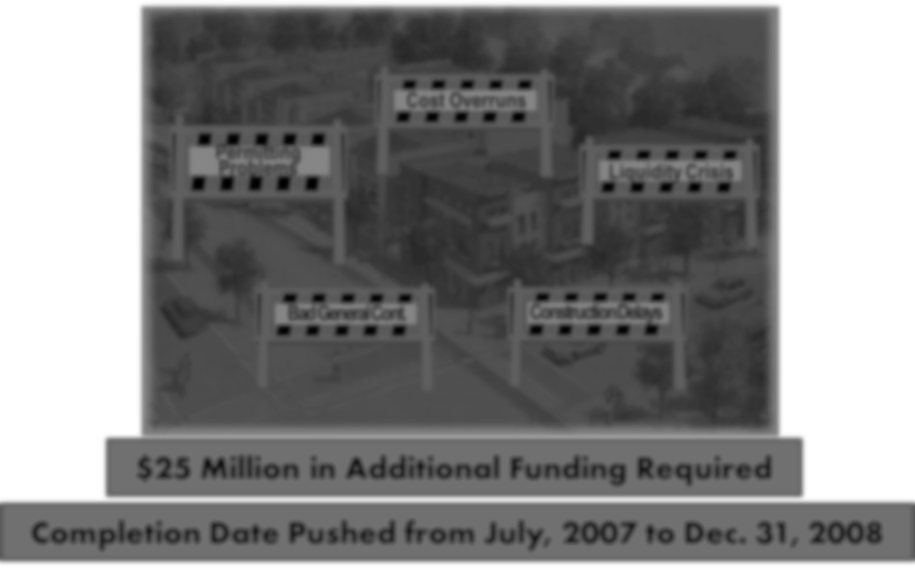
The Investors Sue Acco
Breach of Contract
Negligence
Breach of Fiduciary Duty
5 Types of Fraud
Notes:
Our Hypothetical (3)
The investors all sue, claiming:
Breach of contract
Negligence
Breach of Fiduciary duty
Common law fraud, promissory fraud, fraudulent concealment and real estate fraud and Securities Fraud

Slide 6
There might be some bad documents, but they’re mostly privileged.
General Counsel for Acco
Notes:
You have been hired to defend Acco, whose General Counsel informs you that there might be some bad documents, but they’re mostly privileged.

Slide 7
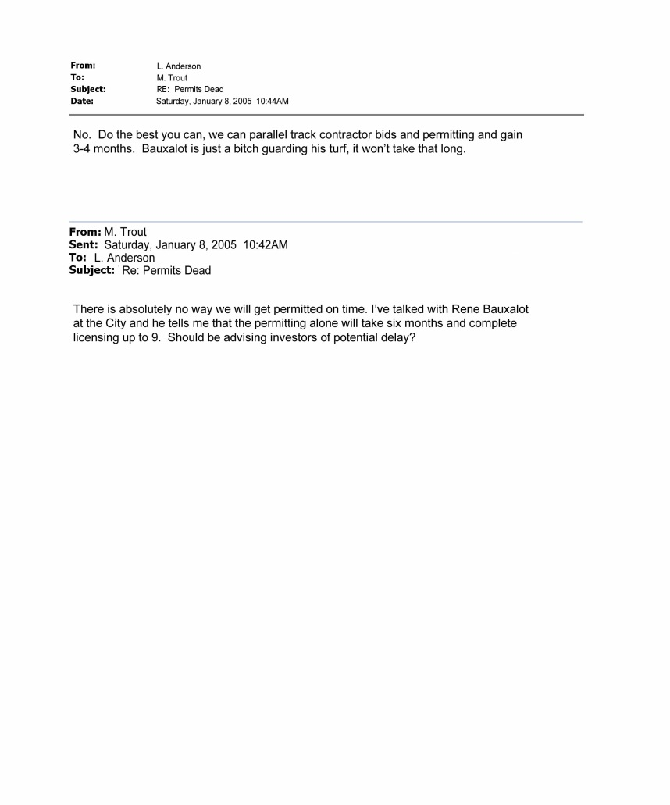
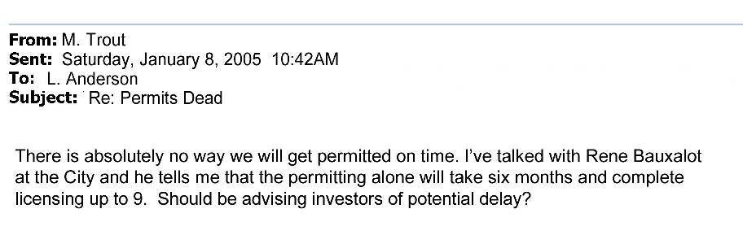
Permitting Problems
ACCO
LLC
Bad doc #1

Slide 8
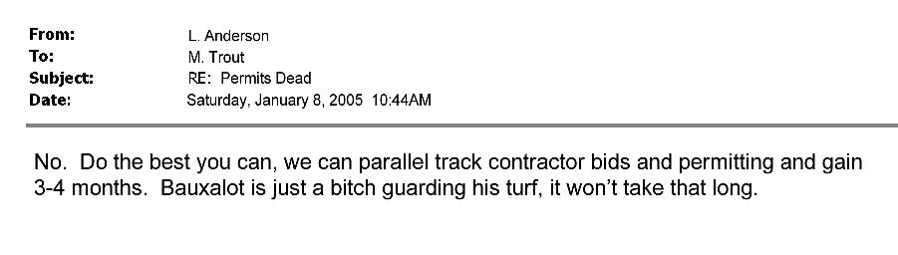
Permitting Problems
ACCO
LLC
Bad doc #1, con’t

Slide 9
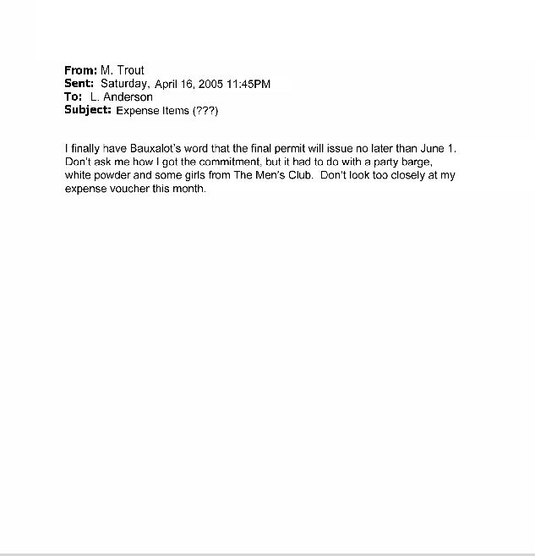
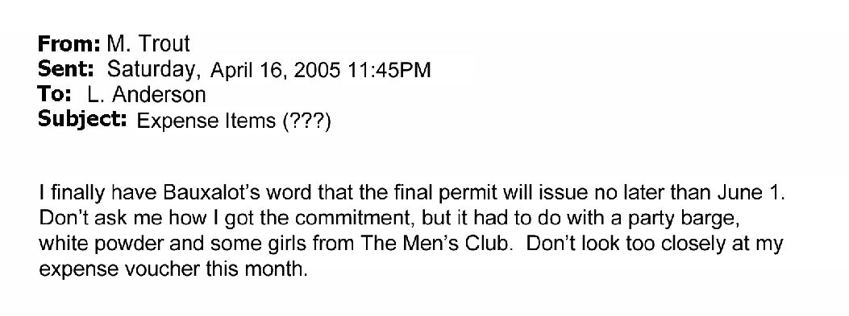
Permitting Problems
ACCO
LLC
No reply from Anderson . Expenses passed on to investors
Bad doc #2

Slide 10
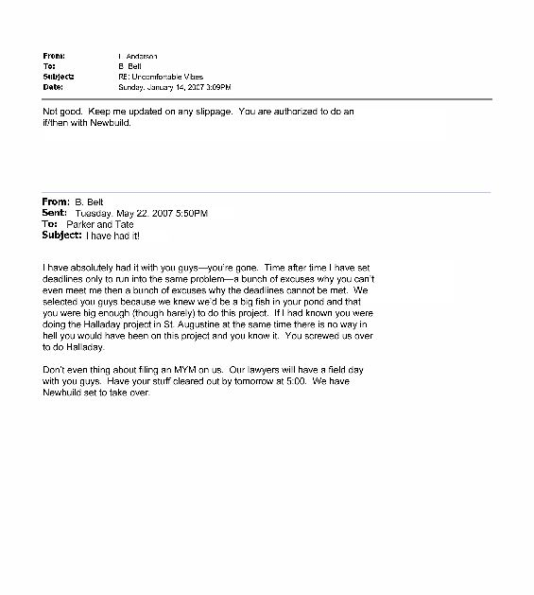
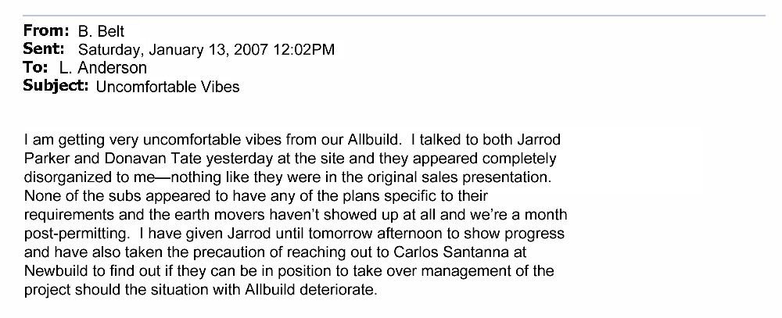
General Contractor
Bad doc #3

Slide 11
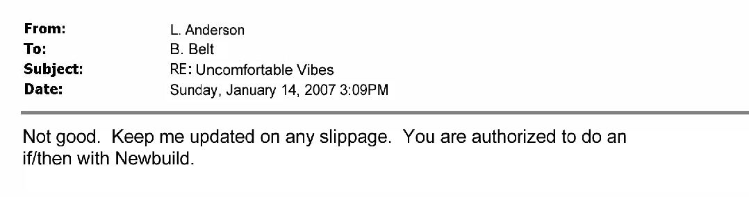
General Contractor
ACCO
LLC
Bad doc #3, con’t

Slide 12
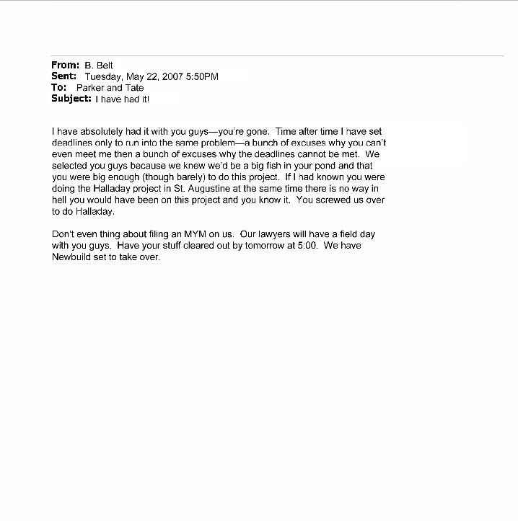
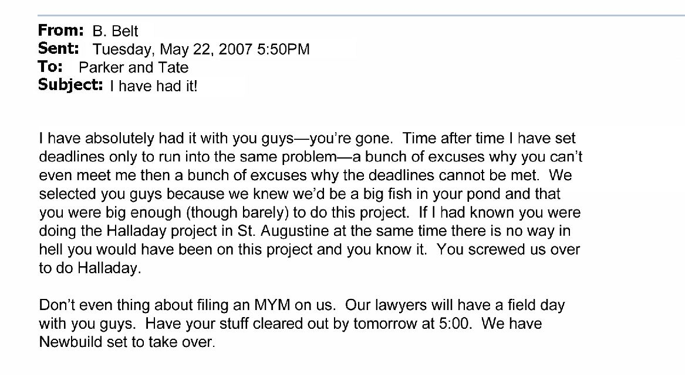
General Contractor
ACCO
LLC
Bad doc #4

Slide 13
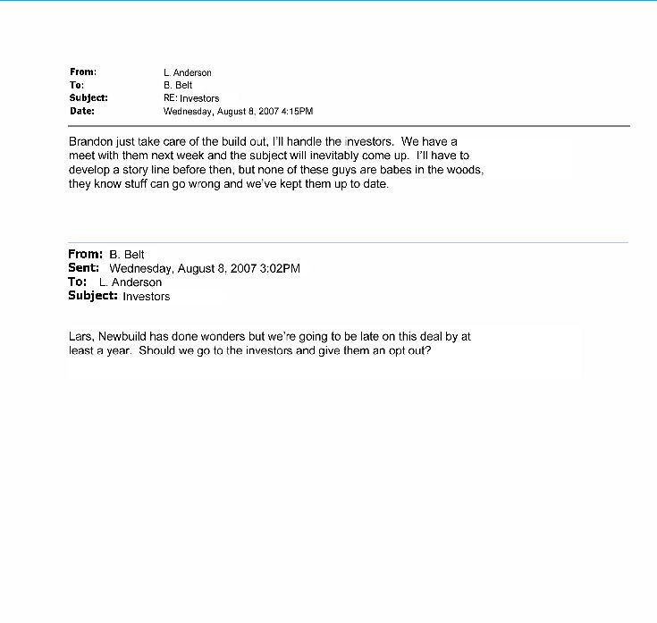
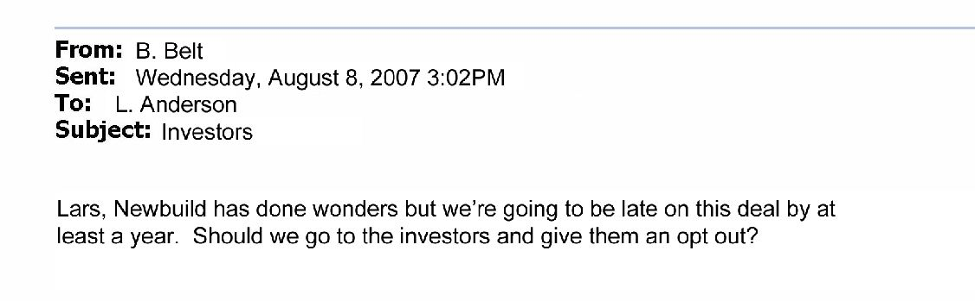
Construction Delays
ACCO
LLC
Bad doc #5

Slide 14
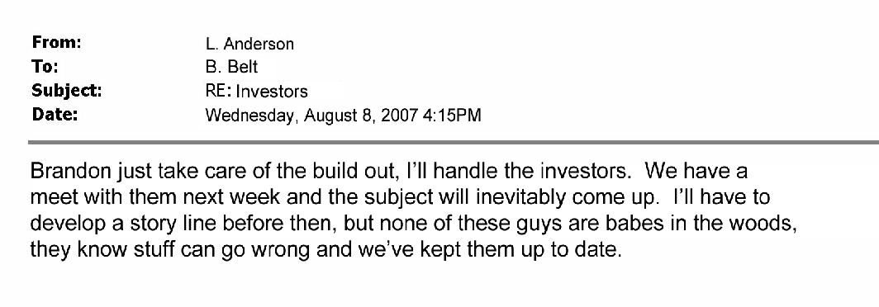
Construction Delays
ACCO
LLC
Bad doc #5 con’t

Slide 15
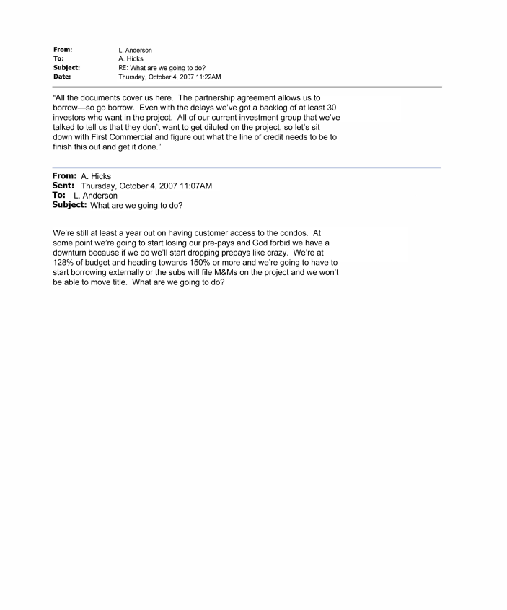
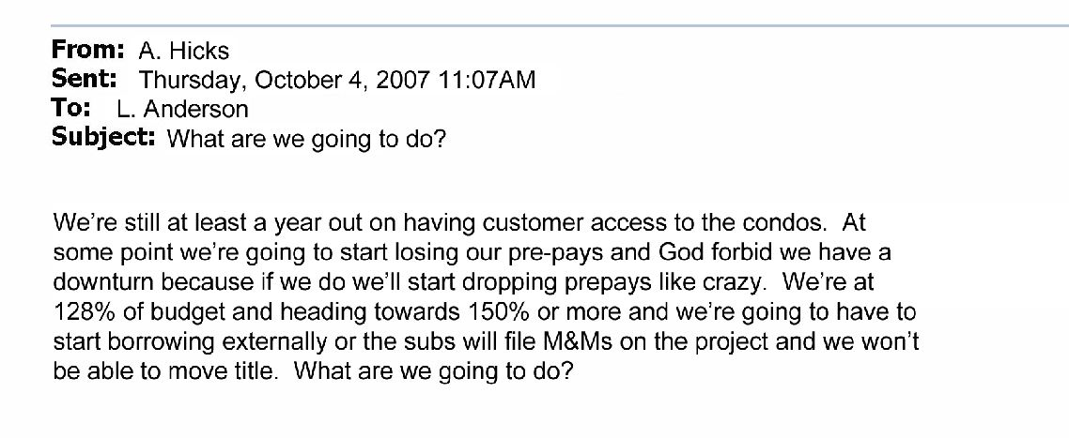
Liquidity Crisis
ACCO
LLC
Bad doc #6

Slide 16
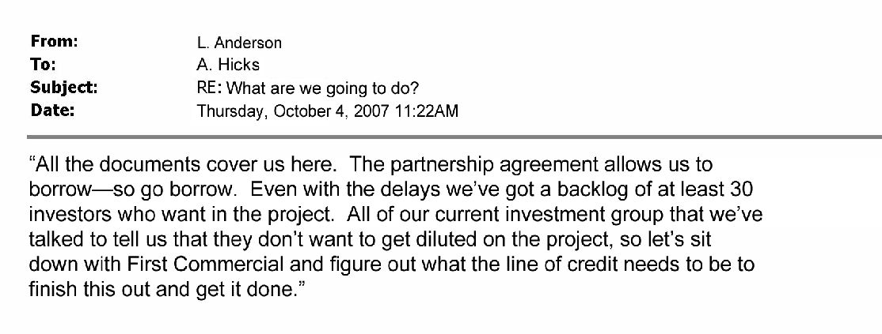
Liquidity Crisis
ACCO
LLC
Bad doc #6 con’t

Slide 17

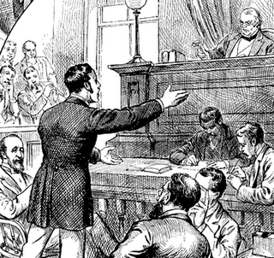
Do I have all the bad docs? Are there more?
Are the bad docs privileged?
Obtain full client acknowledgement and a commitment to full production
What explains these documents?
Transcendent facts?
Discover and test
Orient witnesses to state the case
Notes:
Figure out: how bad is bad?
Do I have all of the bad documents, or are there more out there
Are the bad documents clearly privileged? (No)
Are there truthful neutral or positive explanations?
Do transcendent facts exist?
(2) Obtain full client acknowledgement and a commitment to full production
(3) If neutral to positive explanations or transcendent facts exist, test them
(4) Orient your witnesses to state your case, during deposition and at trial

Slide 18




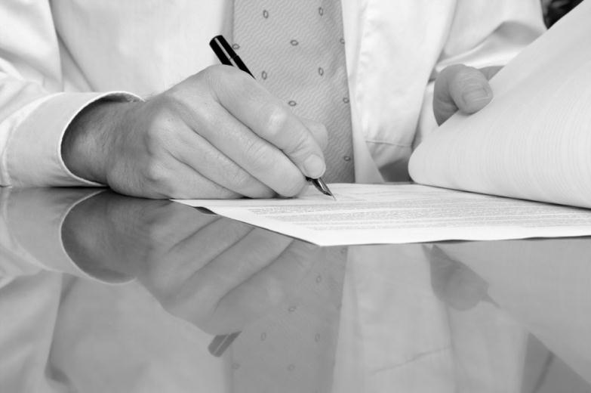
Calling All Documents
Notes:
Step 1: Make sure we have ALL the Bad Documents
Why so critical?
You need to know how they fit into the whole story
You need to know immediately whether there is a neutral or positive explanation or transcendent fact
Late produced documents get magnified:
Your withholding of them announces that you fear them
Forced production creates negative momentum in depositions and before the court

Slide 19

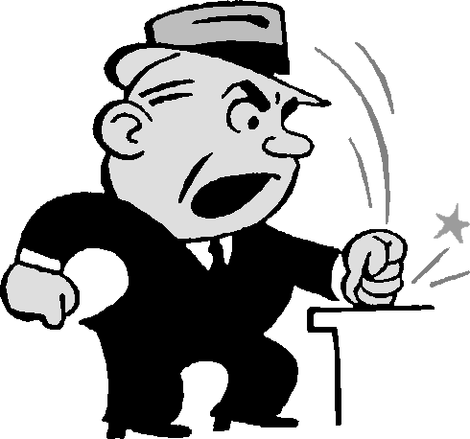
Err on the Side of Production
Privileged
Notes:
Can’t I just claim privilege and make my Opposition work for them?
Recommendation is to err on the side of production, why?
The privilege log is a beacon
The documents in question will be highlighted for the Court, and may impair your or the client’s credibility for the whole case
The combination of document withholding and document volatility increases the chance of a crime or fraud exception finding

Slide 20
Avoid the Worst Case Scenario
Motions to Strike governed by TransAmerican
Leading cause of sustained death penalty sanctions is document withholding and/or destruction
Court infers that if you could stand production, you would have produced.
Notes:
Motions to Strike are governed by the TransAmerican standard
Withholding, or worse yet destroying truly bad and potentially outcome determinative documents is the leading cause of sustained death penalty sanctions
Why? Because the court makes the same inference your opposition makes: if you could stand production, you would have produced.

Slide 21
Test Neutral or Positive Explanations
for reasonableness and acceptability
to your fact finder
Notes:
Step Two: Do I have Neutral or Positive Explanations?
When faced with bad documents, we naturally seek out innocent (neutral or positive) explanations
The key isn’t developing explanations, but rather testing them for reasonableness and acceptability to your fact finder
Examples from our hypotheticals.

Slide 22
Transcendant Facts Make Bad Documents Irrelevant
Opposition knew and approved
They do the same things
Refused a fair “out” when offered
The project or product was doomed anyway
Notes:
Step Two: Do I have transcendent Facts?
A transcendent fact is one that makes my client’s bad documents irrelevant
Examples—
the opposition approved our approach after full disclosure
The opposition does things exactly as we do
The opposition was offered a fair “out” but refused to take it
The project, product, effort, was doomed from the start regardless how we proceeded

Slide 23
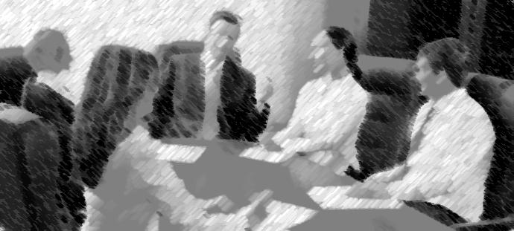
Testing Explanations
Notes:
Step 3: How can I test quickly, cheaply and confidentially?
Ask the members of your staff who aren’t involved in the case, show them the e-mails.
Run the fact pattern past neighbors or friends anonymously or letting them know who you represent
Pick your own random jury and run it by them using your legal assistant or another as the master of ceremonies—costs $around 2,500 rather than $25,000 for full mock trial.

Slide 24

Witness Preparation
Familiar with all bad documents
Acknowledge if/when necessary
Path to positive explanations, transcendent facts
Notes:
Let’s assume we have a horserace — How do we prepare for depositions?
Familiarize all witnesses with the bad documents, whether they created them or not
Acknowledge what you must, but don’t give away more than you must
Give your witnesses the path to go from bad documents to positive explanations or transcendent facts.

Slide 25
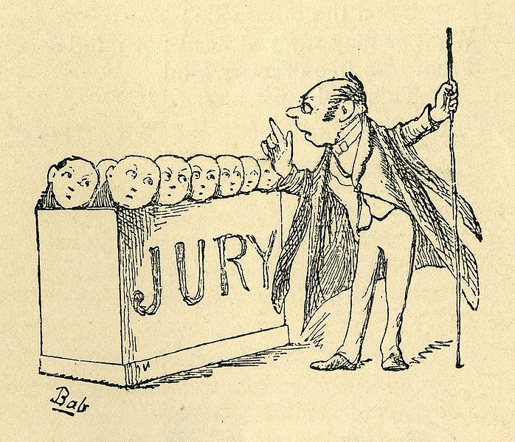
Don’t over-explain
Don’t hide
Explain early and well, give transcendent facts
Over-prove, prove through others
Notes:
Handling The Bad Document Trial—Do’s and Don’ts
Don’t try to explain the documents away one by one—you just bury yourself
Don’t hide from the documents in voir dire or in opening
Give your positive explanations and transcendent facts early—test them
Knock the cover off the positive explanations and transcendent facts
“over” prove them
Prove them through someone or something other than your client.
Image source: http://billofrightsinstitute.org/resources/educator-resources/americapedia/americapedia-bill-of-rights/speedy-trial/

Slide 26
Bad Document Cases Are Hard. Good Counsel is Crucial.
Fight or Flight? If Flight, do so early.
Test explanations, transcendent facts
All on the same game plan
Explain without flinching
Notes:
Summary: Bad Document cases are hard—that’s why the client needs good counsel
Key #1, can I fight or must we flee. If we must flee resolve in quickly before costs and time build
Key #2 develop and test your neutral to positive explanations or transcendent facts
Key #3 get everyone on the same game plan
Key #4 get your message to the jury without flinching

